Slide 1
Generative Adversarial Networks - Workshop

Slide 2
Agenda
Introduction
GANs Architecture
Applications of GANs
Libraries and Tools
Introductory Tutorial of TorchGAN
DeOldify Introduction & Deployment with Streamlit
Questions
Notes:
Presentation – 22 mins
TorchGAN – 10 mins
DeOldify Intro – 2-3 mins
Deployment (Ali) – 10 mins

Slide 3


Real or Fake?

Slide 4

Real or Fake?

Slide 5
Generative Adversarial Networks

Slide 6
Discriminative vs. Generative Algorithm
Discriminative Models:
Predict an output y based on input x
Map features to labels
Example: Classify spam or non spam emails
Generative Models:
Learn data distribution and generate new samples
Probability of features given a label
Example: Images, videos, music, speech etc.

Slide 7
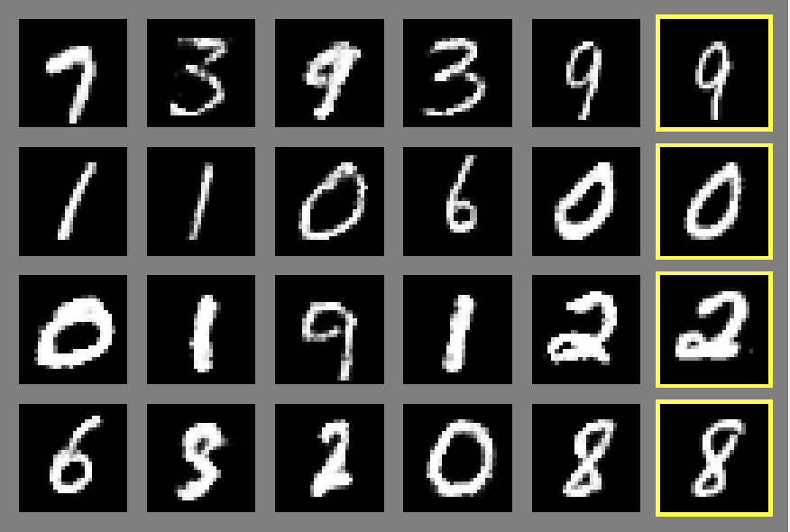
Generative Adversarial Networks (GANs)
Generative Adversarial Networks (GANs):
Deep learning based generative model introduced in 2014 by Ian Goodfellow and co-authors
GANs consist of two neural networks:
Generator: generates new samples from random noise
Discriminator: classifies samples as real or fake

Slide 8
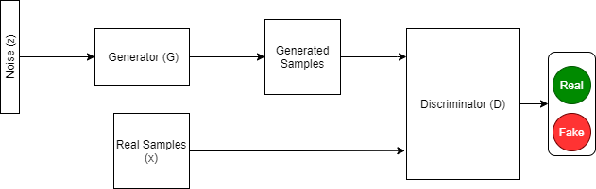
GANs Architecture

Slide 9
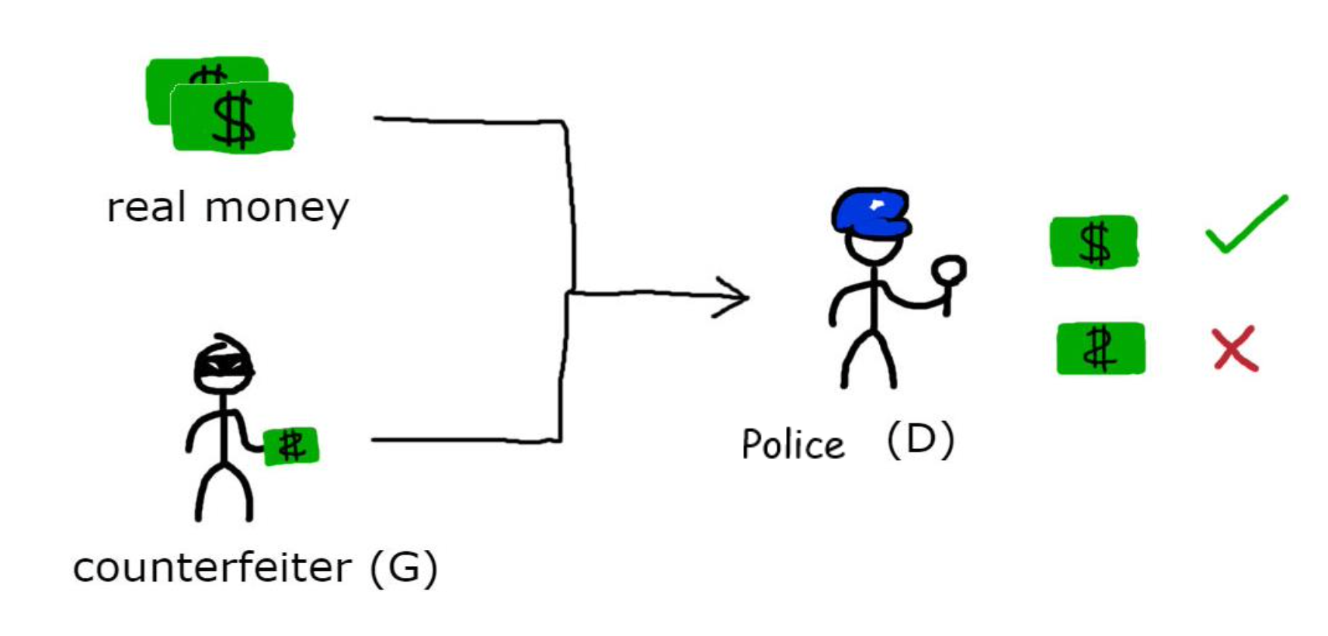
GANs - Analogy
Image Source: https://cfml.se/blog/generative_adversarial_networks/

Slide 10
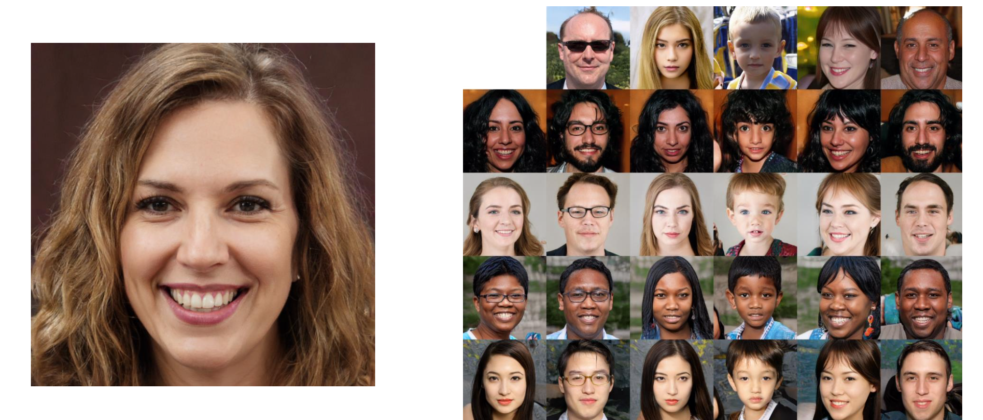
Applications of GANs - StyleGAN

Slide 11
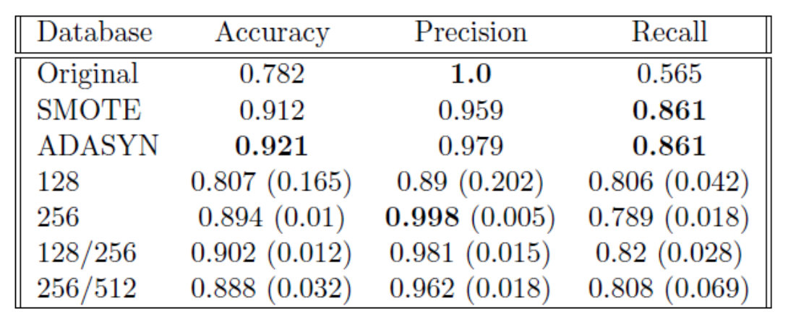
Applications of GANs– Data Augmentation for Classification Tasks
Credit Card Fraud Detection:
492 frauds/ total 284,807 transactions
Highly imbalanced, frauds are only 0.172% of all transactions
Classification Results using Augmented Data

Slide 12
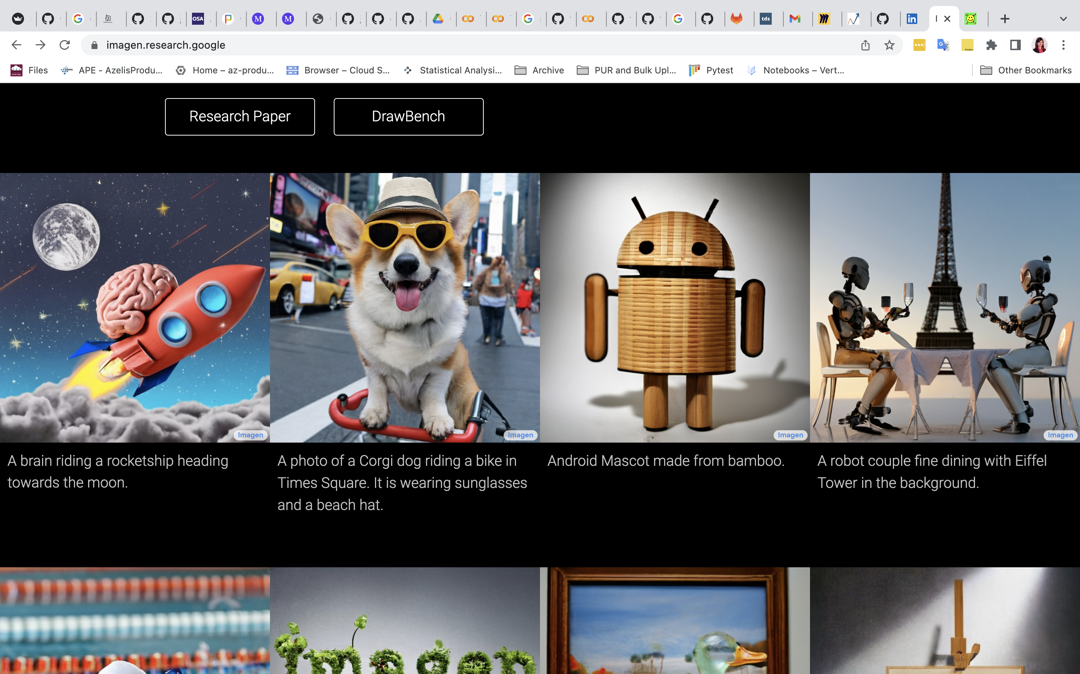
Applications of GANs – Imagen

Slide 13
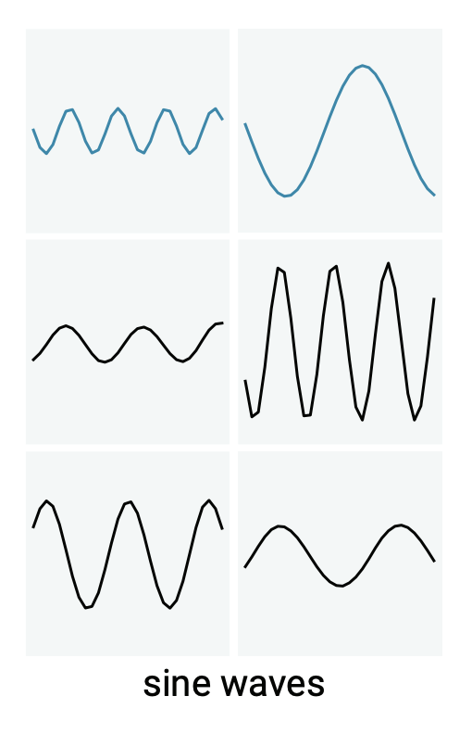
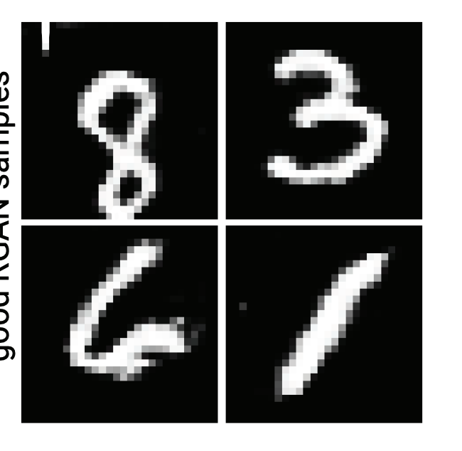
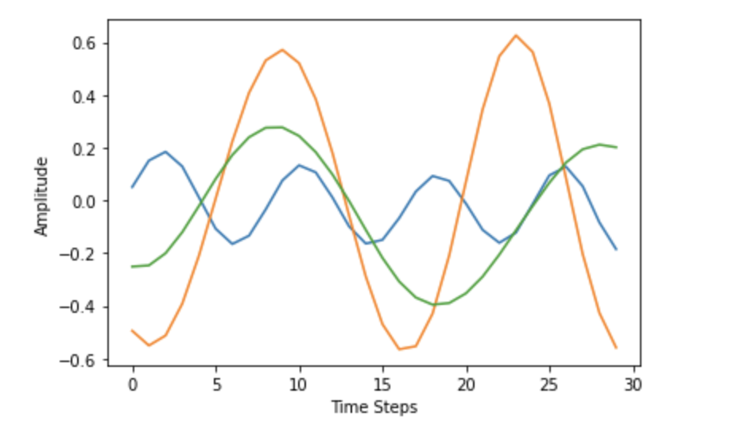
RGAN and RCGAN

Slide 14
Play with GANs https://huggingface.co/spaces/gradio/GANsNRoses

Slide 15
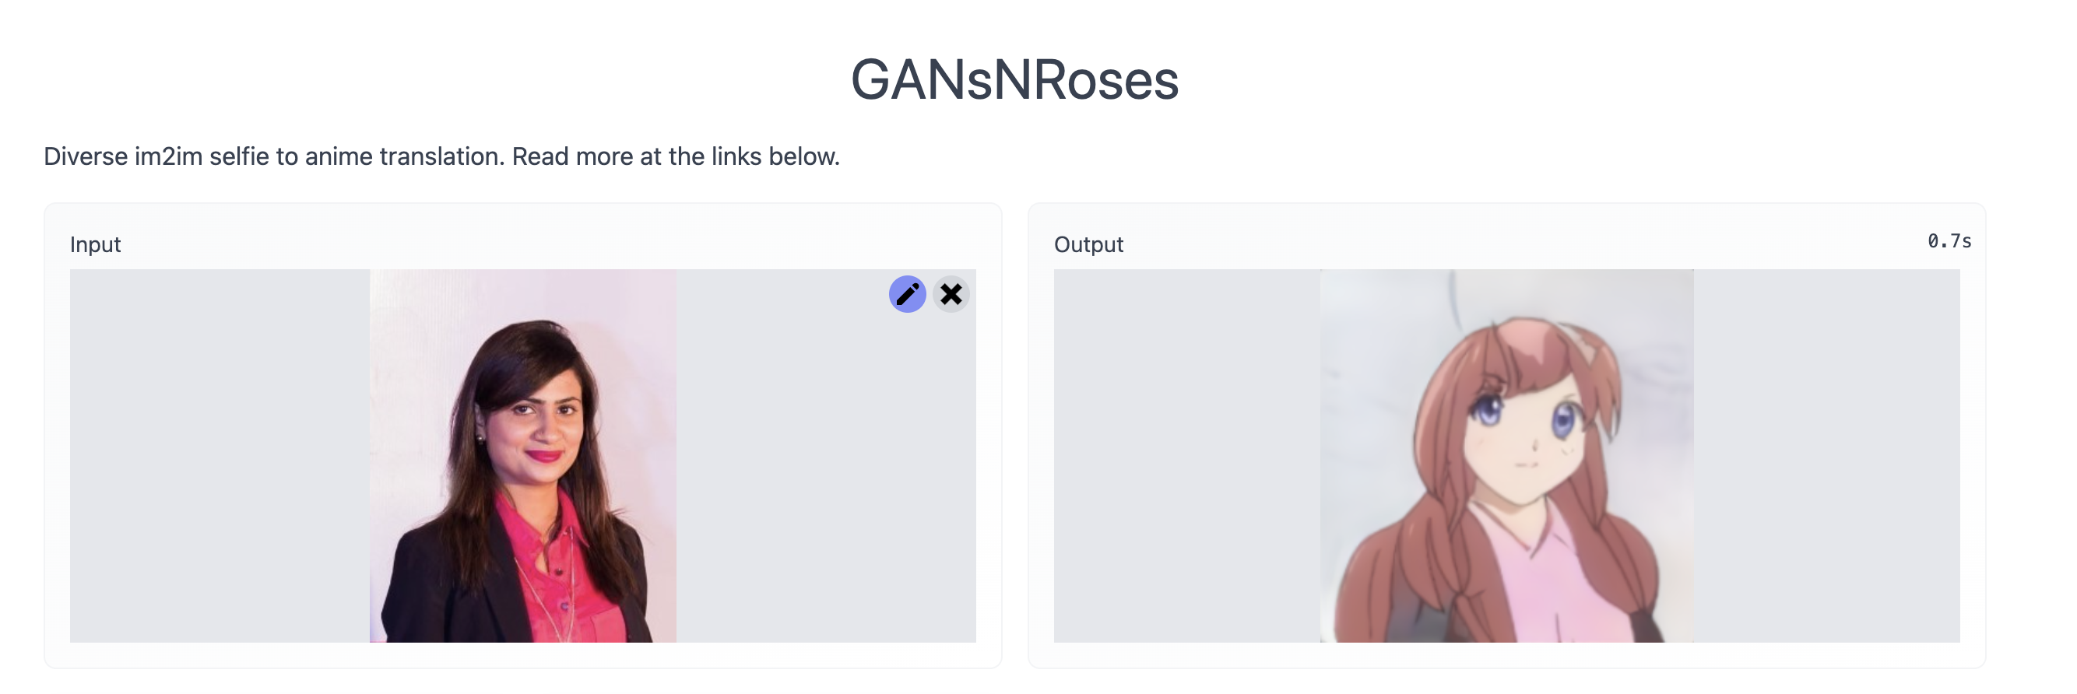
GANsNRoses

Slide 16
GANs Libraries and Tools

Slide 17
Libraries and Tools
1
Tensorflow
TorchGAN - tutorial https://github.com/torchgan/torchgan
1
PyTorch
IBM GAN Toolkit https://github.com/IBM/gan-toolkit
2
2
3
NV Labs Imaginaire https://github.com/NVlabs/imaginaire
4
Mimicry https://github.com/kwotsin/mimicry
5
HyperGAN https://hypergan.gitbook.io/hypergan

Slide 18
Thank you!

Slide 19
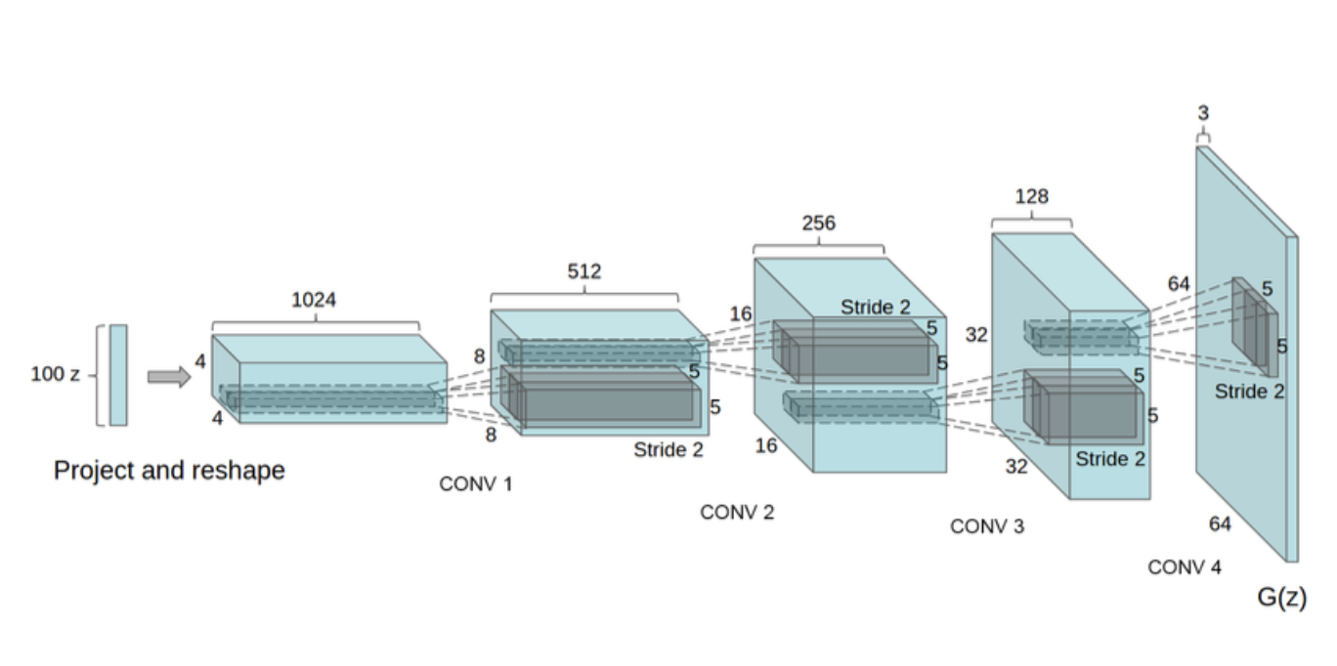
Deep Convolutional Generative Adversarial Networks - DCGANs

